Slide 1


Bexar County COVID-19 by the Numbers
Victor Baker
Maria Ramirez
Courtney Hyland

Slide 2
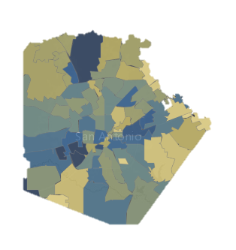
We wanted to know…
For each zip code in Bexar County vs COVID-19 did these factors play a role:
Median Income
Mean Age
Overall Ethnicity

Slide 3
We obtained Bexar County COVID-19 data from the City of San Antonio.
This was compared with data obtained from the Census Bureau API

Slide 4
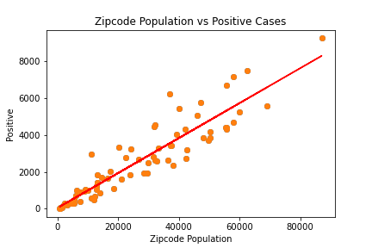
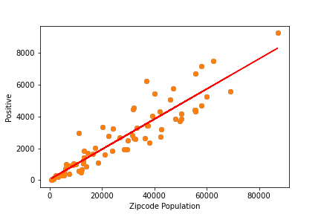
Positivity and Zipcode Population
There is a moderately strong correlation between these factors.

Slide 5
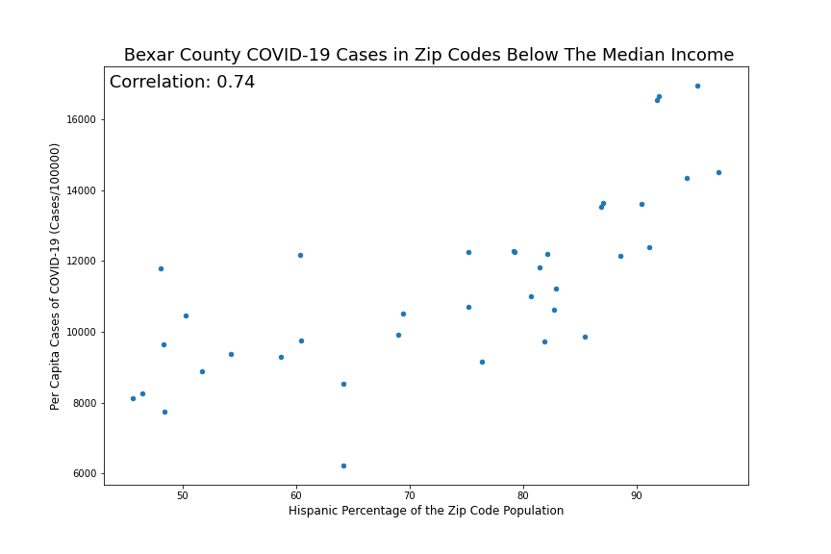
The effects of higher percentage Hispanic Population in Below Median Income Zip Codes
There is a moderately strong correlation between these factors.

Slide 6
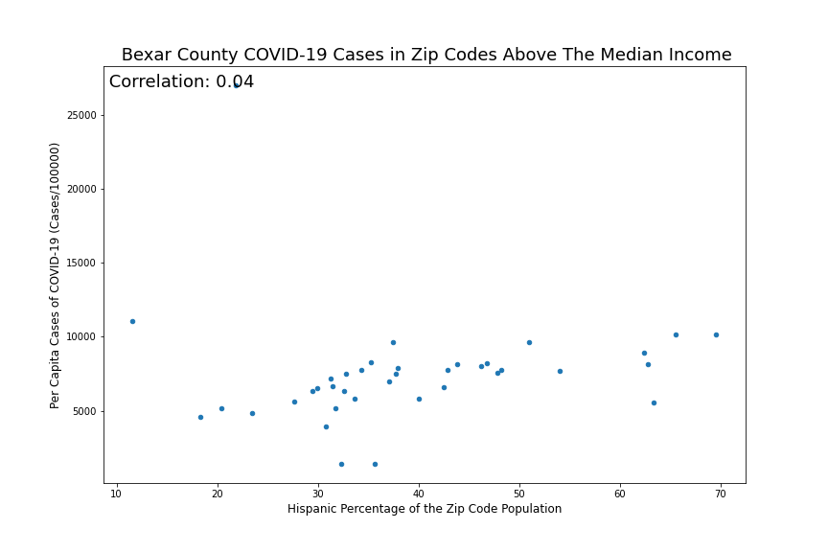
The effects of higher percentage Hispanic Population in Above Median Income Zip Codes
The is no correlation between these factors.

Slide 7
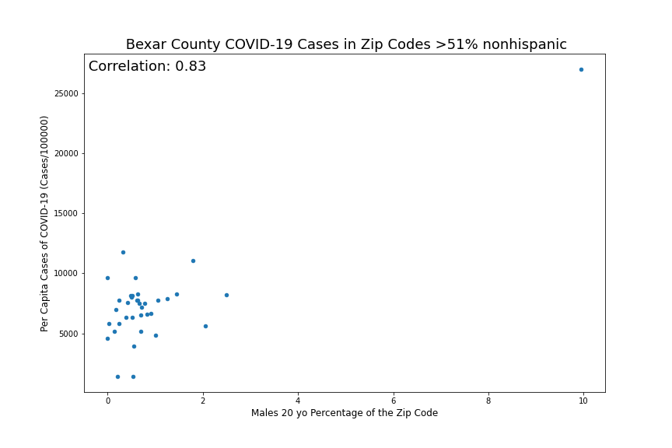
Males aged 20

Slide 8
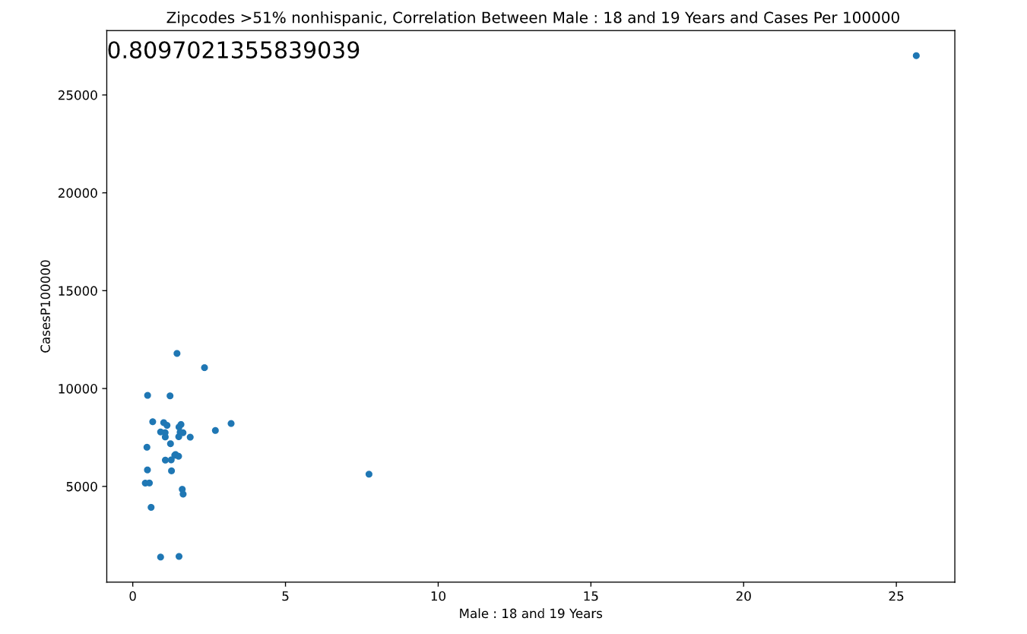
Non-Hispanic Males 18 and 19 Years Old
Non-Hipanic males shows the greatest correlation amongst the other age groups, and vs Hispanics.
Majority of this group made up 0% to 4% of the zip code’s positive cases.

Slide 9
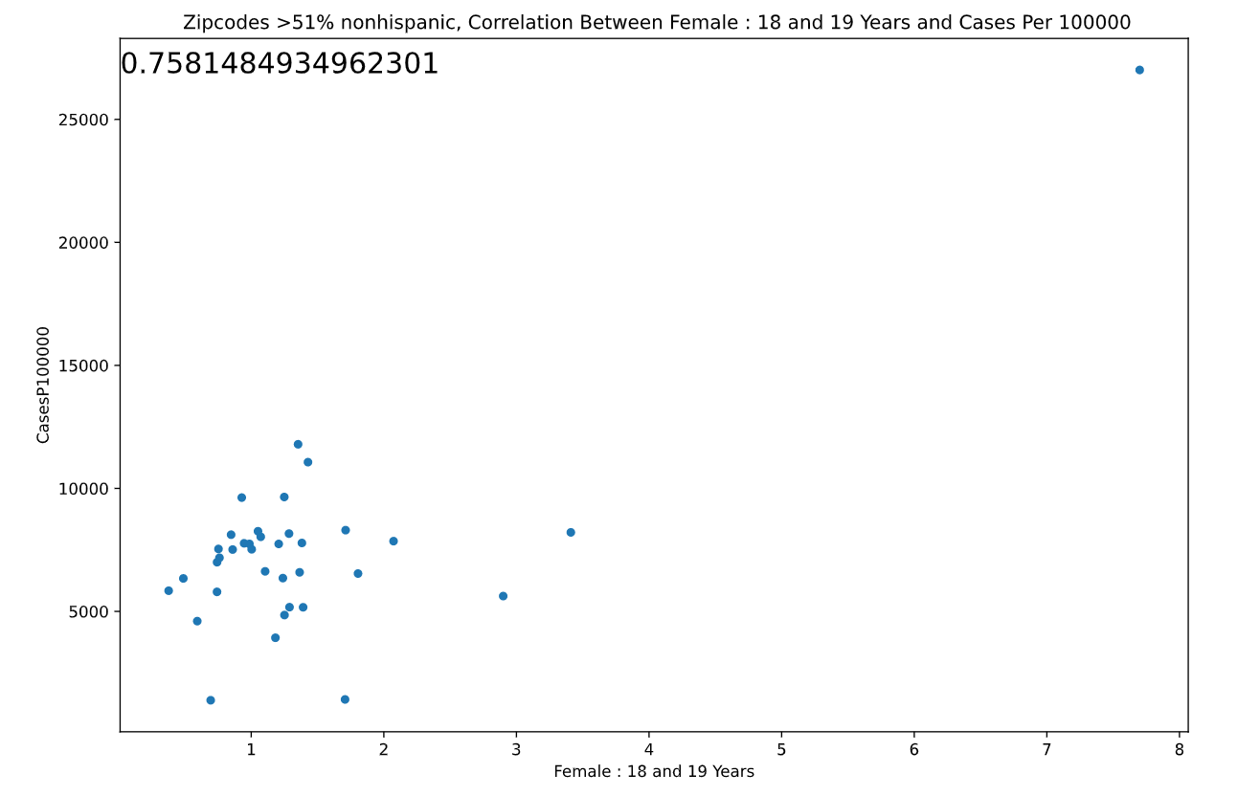
Non-Hispanic Females 18 and 19 Years Old

Slide 10
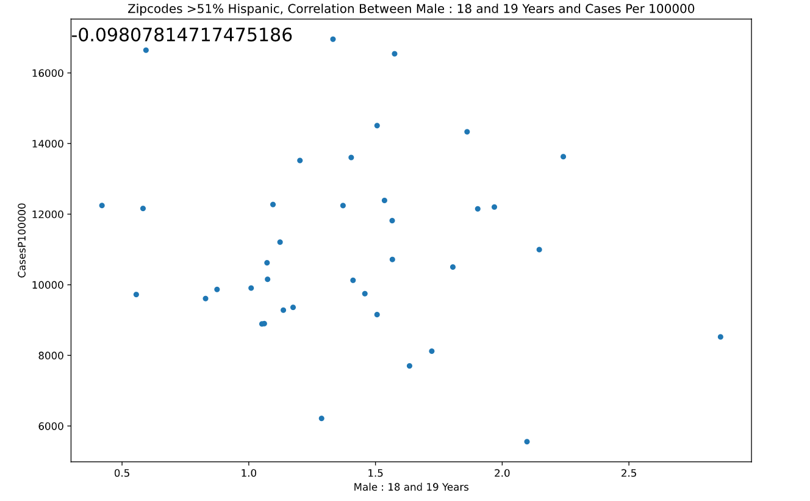
Hispanic Males 18 and 19 Years Old

Slide 11
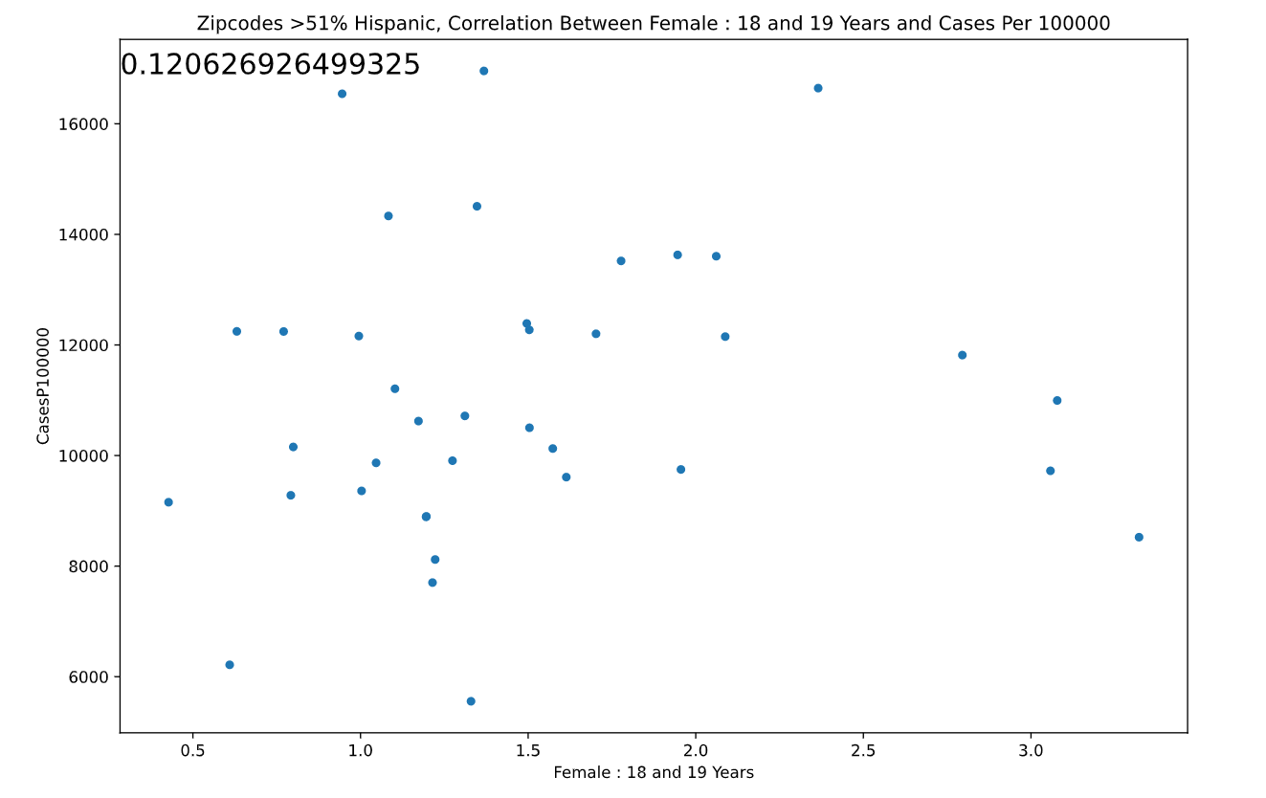
Hispanic Females 18 and 19 Years Old

